Slide 1
The Internal Context of Business
  Labour
  Leadership
  Structure
  Strategy
1
Notes:
What is the internal context of business? The internal context of business includes four broad areas:
Labour – Labour, in a broad sense, involves the people that the company hires and work towards the company’s goals and objectives. In Chapter 2, we will consider the employer-employee relationship and current labour issues in the workplace.
Leadership – Leadership involves the management of the organization that leads and motivates its employees. In Chapter 3, we will consider how management should best manage its workforce, and whether or not traditional approaches to managing people are still relevant for today’s companies.
Structure – The structure of a business can also be a determinant of a businesses’ success. How large or small should a business be in terms of its departments and people? What is the right structure to ensure the optimal amount of productivity, communication, and the ability of an organization to adapt to changes in its external environment?
Strategy – And strategy. In Chapter 5, Strategy will be discussed. We will examine what are various strategies businesses should consider and what strategy is best given their industry, competitive pressures and other influential factors.

Slide 2
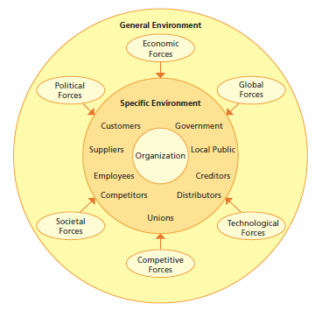
The External Environment of Business
Notes:
What is the external environment of business?
Each factor in an organization’s external environment can be considered as existing in two spheres: a specific sphere or environment within which the organization directly operates, and a general sphere or environment that would encompass the external environments of all organizations in a society.
The specific sphere has been referred to as the environmental domain of the organization. For example, changes in the international environment may be a common factor for all organizations with, say, trade agreements affecting Canadian industry in general. However, some industries may be differentially affected by changes in the international environment via trade agreements. Not all organizations within an industry or within different industries are equally affected by changes in the environment. There are changes that affect all or some industries, and there are changes or factors that influence the direct sphere or environment of specific organizations.
The sphere surrounding the organization’s specific environment is typically referred to as the general environment. The forces that make up the general environment ultimately shape the specific environment of the organization. Consequently, the general environment will also influence the organization’s ability to obtain resources.

Slide 3
Stakeholder and Issue Analysis
Stakeholder engagement → efforts by corporation to understand and involve relevant individuals, groups, or organizations by considering their moral concerns
Issue analysis → effort to understand the source, nature, and extent of a question or matter in dispute facing corporation
  Will result in addressing or resolving the matter

Slide 4
Issue Analysis
Two approaches to issue analysis:
  The issues management process
  Issue salience (materiality) analysis
Notes:
Archie B. Carroll, Business and Society: Ethics and Stakeholder Management (Cincinnati, OH: South-Western Publishing, 1989), 479–489; and John M. Bryson, Strategic Planning for Public and Nonprofit Organizations (San Fran-cisco: Jossey-Bass Publishers, 1988).

Slide 5
The Issue Management Process
Involves six steps:
  Identification of issues
  Analysis of issues
  Ranking or prioritizing of issues
  Formulating issue response
  Implementing issue response
  Monitoring and evaluating issue response
Sources: Carroll, 1989; Bryson, 1988
Notes:
Archie B. Carroll, Business and Society: Ethics and Stakeholder Management (Cincinnati, OH: South-Western Publishing, 1989), 479–489; and John M. Bryson, Strategic Planning for Public and Nonprofit Organizations (San Fran-cisco: Jossey-Bass Publishers, 1988).

Slide 6
Issue Materiality
Issue materiality (sustainability materiality) → question or matter that is sufficiently important to warrant management’s attention
An aspect or issue should be reported if it meets these criteria:
  Reflects the organization’s significant economic, environmental, and social impacts
  Substantively influence the assessments and decisions of stakeholders

Slide 7
Assessment of Ethical
Implications in Business Decisions
Value judgments → subjective evaluations of what is considered important
  Based on how managers intuitively feel about the goodness or rightness of various goals
Moral standards → the means by which individuals judge their actions and the actions of others
  Based upon accepted behaviour in society

Slide 8
Ethical Leadership Forms
Research on leadership identifies three possible forms applicable to the ethics of business and corporate social responsibility:
  Ethical → communicate ethical standards and encourage ethical conduct
  Responsible → narrow orientation focused on financial performance and extended orientation with stakeholder view
  Servant leadership → emphasizes concern for others, and combines motivation to lead with the need to serve others
    Includes the design and implementation of corporate ethics programs

Slide 9

Describing Corporate
Social Responsibility (CSR)
The way a corporation achieves a balance among it economic, social, and environmental responsibilities in its operations so as to address shareholder and other stakeholder expectations

Slide 10
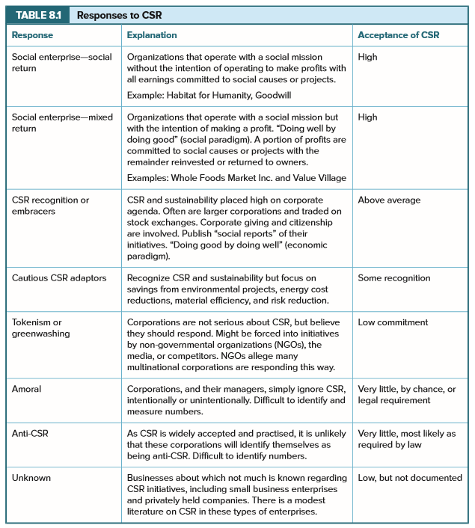
Responses to CSR
Response | Explanation | Acceptance of CSR
Social enterprise—social return | Organizations that operate with a social mission without the intention of operating to make profits with all earnings committed to social causes or projects. Example: Habitat for Humanity, Goodwill | High
Social enterprise—mixed return | Organizations that operate with a social mission but with the intention of making a profit. “Doing well by doing good” (social paradigm). A portion of profits are committed to social causes or projects with the remainder reinvested or returned to owners. Examples: Whole Foods Market Inc. and Value Village | High
CSR recognition or embracers | CSR and sustainability placed high on corporate agenda. Often are larger corporations and traded on stock exchanges. Corporate giving and citizenship are involved. Publish “social reports” of their initiatives. “Doing good by doing well” (economic paradigm). | Above average
Cautious CSR adaptors | Recognize CSR and sustainability but focus on savings from environmental projects, energy cost reductions, material efficiency, and risk reduction. | Some recognition
TABLE 8.1

Slide 11
Responses to CSR Cont’d…
Response | Explanation | Acceptance of CSR
Tokenism or greenwashing | Corporations are not serious about CSR, but believe they should respond. Might be forced into initiatives by non-governmental organizations (NGOs), the media, or competitors. NGOs allege many multinational corporations are responding this way. | Low commitment
Amoral | Corporations, and their managers, simply ignore CSR, intentionally or unintentionally. Difficult to identify and measure numbers. | Very little, by chance, or legal requirement
Anti-CSR | As CSR is widely accepted and practised, it is unlikely that these corporations will identify themselves as being anti-CSR. Difficult to identify numbers. | Very little, most likely as required by law
Unknown | Businesses about which not much is known regarding CSR initiatives, including small businesses and privately held corporations. There is a modest literature on CSR in these types of enterprises. | Low, but not documented
TABLE 8.1

